Slide 1






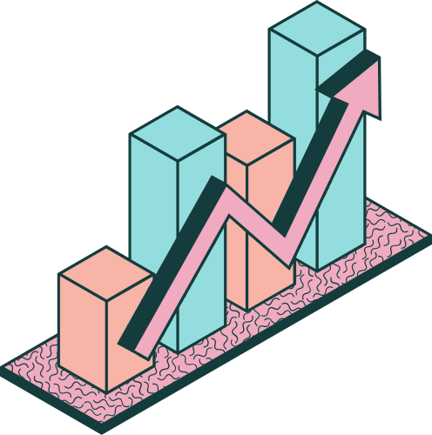



DATA ANALYSIS OF STUDENT
SCORES USING
PYTHON
By : Biswajeet Prasad

Slide 2
INTRODUCTION
We have a Student data set and we need to analyzes student performance data using Python, pandas, and seaborn. The dataset includes over 30,000+ records with information like gender, study hours, parental education, and test scores in math, reading, and writing. The goal is to clean the data, handle missing values, and visualize key patterns to understand which factors impact student achievement.

Slide 3
🧹 DATA CLEANING & PREPROCESSING
Using pandas, we cleaned the dataset by:
Dropping unnecessary columns (Unnamed: 0)
Replacing or removing missing values (fillna, dropna, median)
Standardizing categorical entries (e.g., replacing "05-Oct" with "5-10" in WklyStudyHours)
This step ensured that the dataset was consistent and ready for analysis.

Slide 4
DATA CLEANING & PREPROCESSING – CODE USED
# 1. Importing Required Libraries
import pandas as pd
# 2. Load the dataset
df = pd.read_csv("student_scores.csv")
# 3. Drop unnecessary index column
df.drop(columns=["Unnamed: 0"], inplace=True)
# 4. Replace incorrect value in WklyStudyHours column
df["WklyStudyHours"] = df["WklyStudyHours"].replace("05-Oct", "5-10")

Slide 5
DATA CLEANING & PREPROCESSING – CODE USED
# 5. Check for missing values
df.isnull().sum()
# 6. Fill missing categorical values
df["EthnicGroup"].fillna("unknown", inplace=True)
# 7. Fill missing numerical values with median
df["NrSiblings"] = df["NrSiblings"].fillna(df["NrSiblings"].median())
# 8. Drop any remaining rows with missing values (optional/if needed)
df.dropna(inplace=True)

Slide 6
EXPLORATORY DATA ANALYSIS (EDA)
Using pandas, matplotlib, and seaborn, I explored
relationships and patterns in the data.
Key insights included:
Distribution of diffrent scores with number of student
Distribution by Ethnic group
Reading score by parents education
Maths Score By Gender
Maths Score By Study Hour

Slide 7
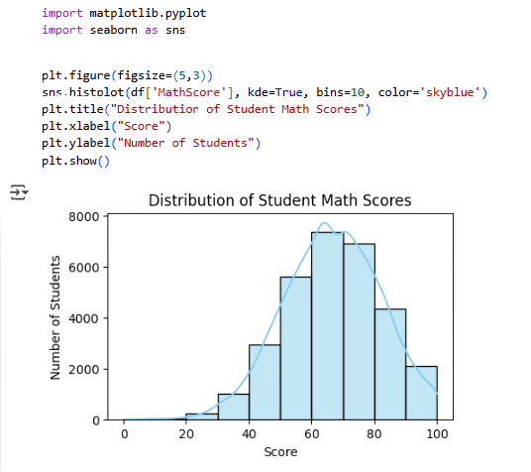

Slide 8
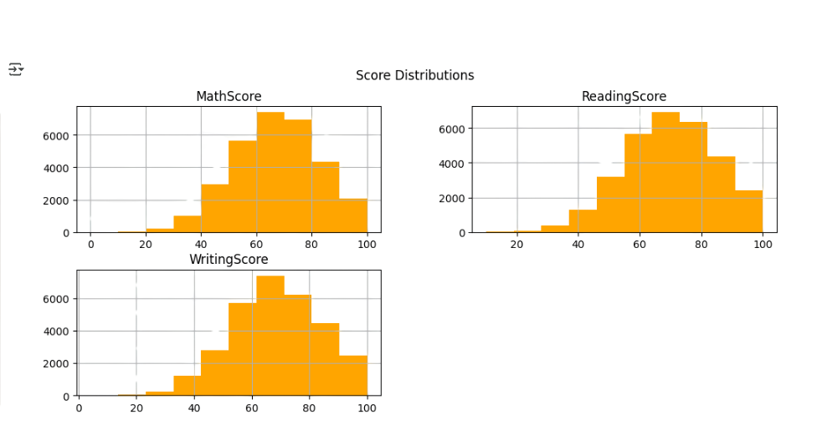

Slide 9
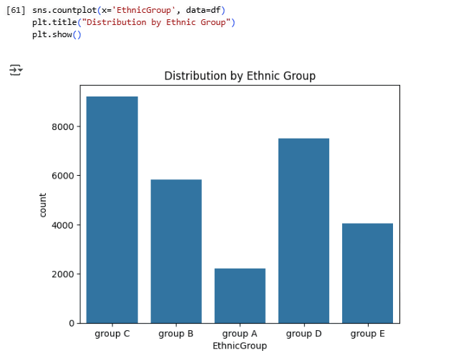

Slide 10
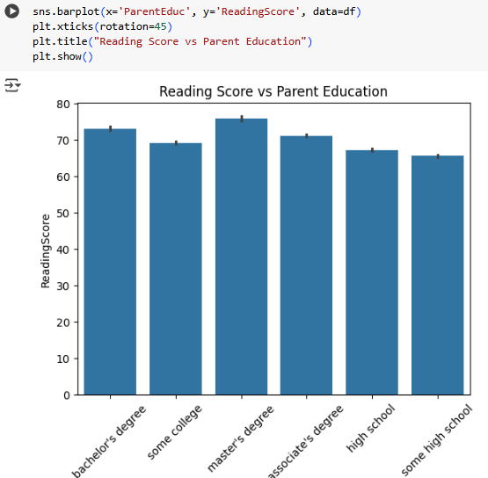

Slide 11
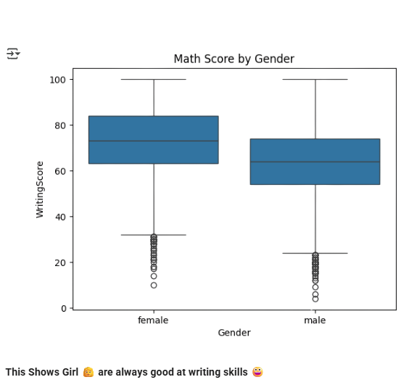

Slide 12
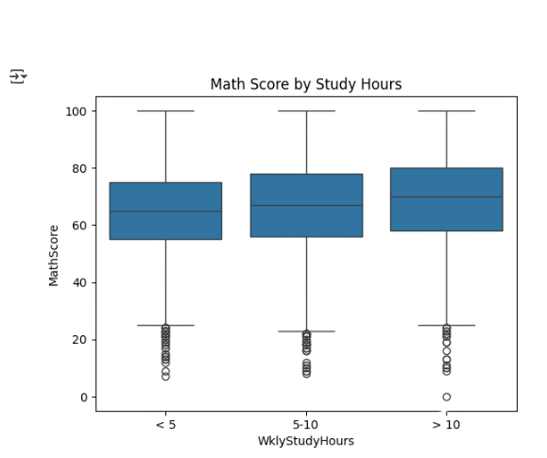

Slide 13
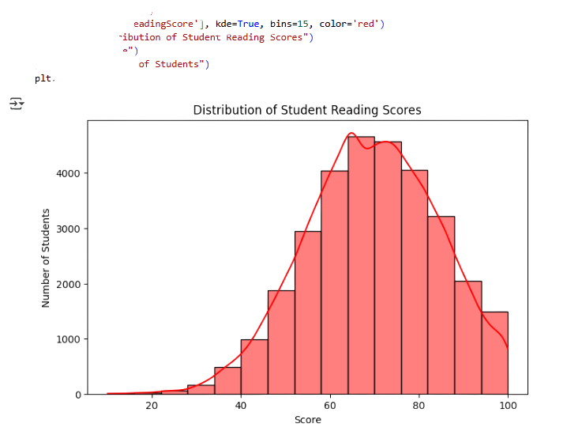

Slide 14
SUMMARY OF FINDINGS
Insight Observation
📘 Test Preparation Students who completed test prep scored significantly higher
⏱️ Study Hours More study hours led to better scores, especially beyond 10 hours/week.
🧮 Subject Correlation Math, Reading, and Writing scores are strongly correlated
👨‍👩‍👧 Parental Education Higher parental education is associated with better student performance
👩 Gender Differences Females slightly outperform over males.
🧑🏽‍🤝‍🧑🏽 Ethnic Group Performance varies slightly across ethnic groups,
possibly due to access/resources

Slide 15

INSIGHTS THAT MATTER & THE WAY FORWARD
🧠 Smarter Prep, Stronger Performance
Test preparation and consistent study routines clearly boost scores — structured learning pays off.
🏫 Background Matters, But So Does Support
Students with less academic family support can excel — if given the right guidance and encouragement.
📊 Data Shows Direction
High inter-subject correlation suggests a need for balanced skill-building, not just subject-specific focus.
🌍 Equity Isn’t Optional
Slight performance gaps across demographics call for inclusive strategies — equity must be embedded, not added.
🚀 What Next? Empower, Personalize, Repeat
Expand access to prep programs and peer mentoring
Promote smart study habits early
Engage families through outreach
Personalize learning for diverse needs

Slide 16






THANK YOU!
LET’S CONNECT
WWW.LINKEDIN.COM/IN/DATAWITHBISWAJEET
WWW.GITHUB.COM/DATAWITHBISWAJEET
DATAWITHBISWAJEET@GMAIL.COM

